Slide 1

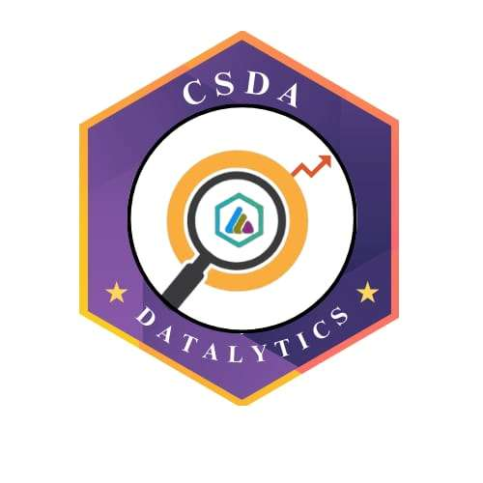

DATATHON ’26
29-01-2026
Basic Details of the Team and Problem Statement
Problem Statement Title: Analyzing Awareness, Usage, and Impact of Micro-Napkins
Team Name: Teach Shapers
Institute Name: Sri Ramakrishna College of Arts And Science For Women
DATATHON 2026
Notes:
1.7.2013
‹#›

Slide 2

DATASET OVERVIEW AND SOURCING
Dataset Overview: The solution design is supported by secondary datasets and domain-specific observations related to:
Sanitary waste generation statistics in rural and semi-urban India
Environmental impact data on plastic-based sanitary products
Health risk data associated with improper biomedical waste disposal
Solar energy availability and thermal efficiency benchmarks
Data Sources:
Government and NGO reports on menstrual hygiene management
Environmental studies on waste incineration and emissions
Renewable energy and solar-thermal efficiency studies
Field-level observations from schools and community sanitation programs
These datasets guided feasibility, capacity estimation, and system design decisions.
DATATHON 2026
2
Notes:
1.7.2013
‹#›

Slide 3
TOOLS AND TECHNOLOGIES
Hardware & Core Technologies:
Solar thermal reflector system (foldable and portable)
Absorber plate with insulated incineration chamber
Ceramic / metal heat storage plates
Dual-chamber incinerator (pre-drying + combustion)
Chimney with smoke control design
Supporting Technologies:
Lime-based granular disinfectant (Calcium Hydroxide)
Passive airflow and gravity-based sliding tray mechanism
Software / Analytical Tools (Design Phase):
Basic thermal calculations
Feasibility and cost analysis tools
Conceptual design modelling
DATATHON 2026
2
Notes:
1.7.2013
‹#›

Slide 4
MODEL DEVELOPMENT & EVALUATION
Model Name: NAPKILL SMARTBIN
Model Development: The system is designed as a solar-thermal incineration model that operates without electricity. It integrates heat capture, storage, pre-drying, and high-temperature incineration into a compact unit.
Evaluation Parameters:
Temperature range achieved (400–600°C)
Time taken for complete incineration (7–10 minutes)
Pathogen destruction effectiveness
Smoke and odor reduction
Cost efficiency and portability
Model Accuracy / Effectiveness:
Near-complete destruction of pathogens
Minimal residue output in the form of sterile ash
Stable performance with thermal storage even during low sunlight
DATATHON 2026
3
Notes:
1.7.2013
‹#›

Slide 5
INSIGHTS & FINDINGS
Findings:
Pre-drying significantly reduces odor and ensures complete combustion
Solar thermal reflectors efficiently concentrate sunlight without electrical input
Lime-based disinfectant enhances hygiene before incineration
Decentralized disposal reduces environmental burden and transport costs
The system is suitable for schools, rural communities, and off-grid locations
Key Insight: Solar-thermal incineration is a viable, low-cost alternative to electric or fuel-based sanitary waste disposal systems.
DATATHON 2026
3
Notes:
1.7.2013
‹#›

Slide 6
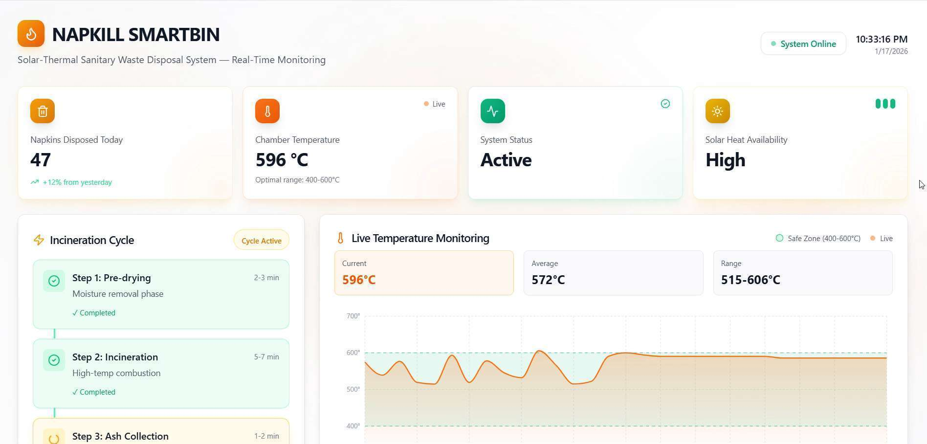
DATA VISUALIZATION
Visual Elements Suggested for Slide:
Process flow diagram of NAPKILL SMARTBIN
Temperature vs. time graph during incineration
Cost comparison chart with electric incinerators
Environmental impact reduction infographic
Visualization Dashboard(Video):
GitHub Link:
https://github.com/Gayathrisree23/napkill-smartbin
DATATHON 2026

Slide 7
CONCLUSION
NAPKILL SMARTBIN presents a sustainable, affordable, and decentralized solution to sanitary napkin waste disposal. By leveraging solar-thermal energy and simple mechanical design, the system eliminates reliance on electricity, minimizes environmental impact, and ensures hygienic disposal. Its portability and low cost make it highly suitable for rural, semi-urban, and institutional settings. The innovation demonstrates strong technical, economic, and environmental feasibility with high social impact potential.
DATATHON 2026

Slide 8
Team Member Details
Team Member 1 Name: Gayathrisree P
Branch: CS Stream: BCA Year: II
Team Member 2 Name:
Inas Fathima C
Branch: CS Stream: BCA Year: II
DATATHON 2026
Notes:
1.7.2013
‹#›

